Slide 1

Advanced Clustering

Slide 2
DBSCAN: Density-Based Clustering

Slide 3
DBSCAN: Density Based Clustering
DBSCAN is a density based clustering algorithm which can be used to identify clusters of any shape in a data set containing noise and outliers.
The basic idea behind the density-based clustering approach is derived from a human intuitive clustering method.
For instance, by looking at the figure below, one can easily identify four clusters along with several points of noise, because of the differences in the density of points.

Slide 4
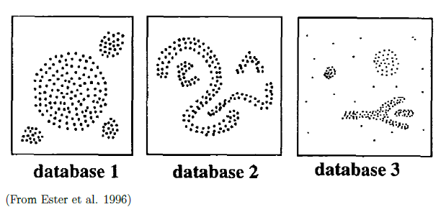
DBSCAN: Density Based Clustering

Slide 5
DBSCAN: Density Based Clustering
Clusters are dense regions in the data space, separated by regions of lower density of points.
The DBSCAN algorithm is based on this intuitive notion of “clusters” and “noise”.
The key idea is that for each point of a cluster, the neighborhood of a given radius has to contain at least a minimum number of points.

Slide 6
DBSCAN: Density Based Clustering
Partitioning methods (K-means, PAM clustering) and hierarchical clustering are suitable for finding spherical-shaped clusters or convex clusters.
In other words, they work well only for compact and well separated clusters. Moreover, they are also severely affected by the presence of noise and outliers in the data.
Unfortunately, real life data can contain: i) clusters of arbitrary shape such as those shown in the figure below (oval, linear and “S” shape clusters); ii) many outliers and noise.

Slide 7
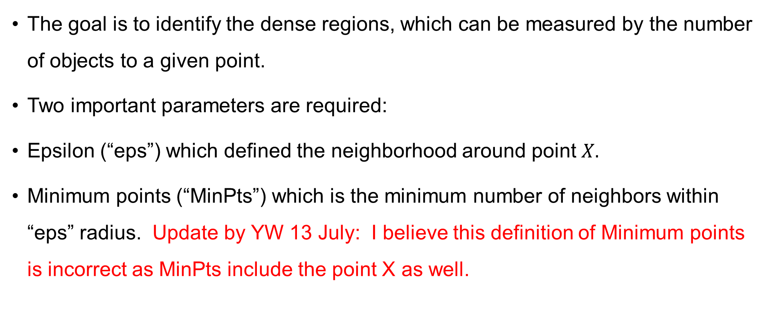
DBSCAN: Density Based Clustering Algorithm
The goal is to identify the dense regions, which can be measured by the number of objects to a given point.
Two important parameters are required:
Epsilon (“eps”) which defined the neighborhood around point $X.$
Minimum points (“MinPts”) which is the minimum number of neighbors within “eps” radius. Update by YW 13 July: I believe this definition of Minimum points is incorrect as MinPts include the point X as well.

Slide 8
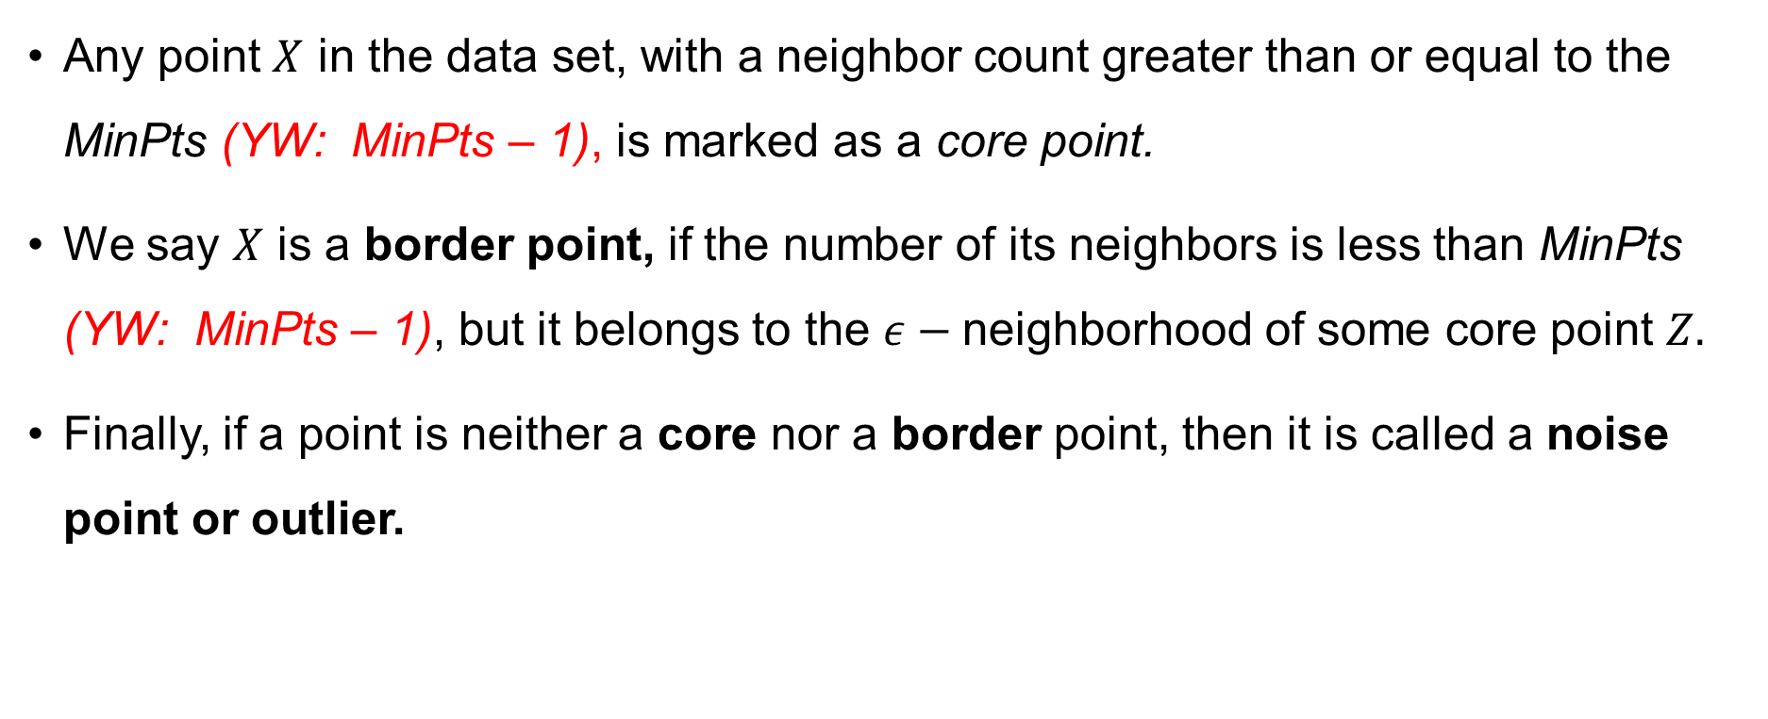
DBSCAN: Density Based Clustering Algorithm
Any point $X$ in the data set, with a neighbor count greater than or equal to the MinPts (YW: MinPts – 1), is marked as a core point.
We say $X$ is a border point, if the number of its neighbors is less than MinPts (YW: MinPts – 1), but it belongs to the $ε−$neighborhood of some core point $Z.$
Finally, if a point is neither a core nor a border point, then it is called a noise point or outlier.

Slide 9

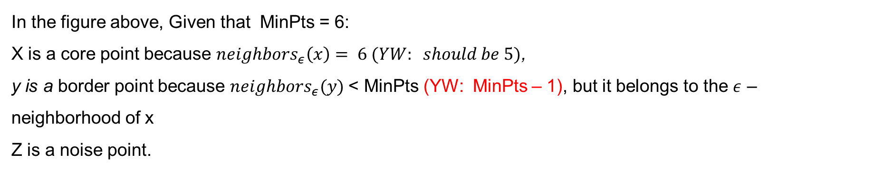
DBSCAN: Density Based Clustering Algorithm
In the figure above, Given that MinPts = 6:
X is a core point because $neighbors_{ε}\left(x\right)= 6 (YW: should be 5)$,
y is a border point because $neighbors_{ε}(y)$< MinPts (YW: MinPts – 1), but it belongs to the $ε$ – neighborhood of x
Z is a noise point.

Slide 10
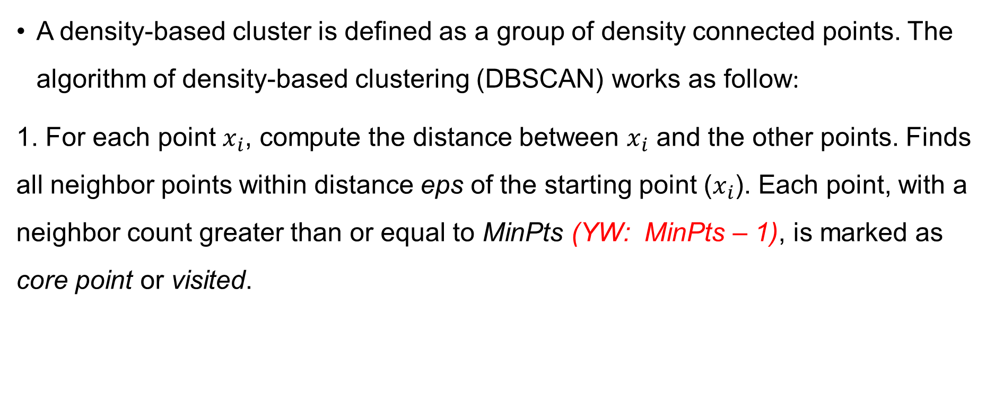
DBSCAN: Density Based Clustering Algorithm
A density-based cluster is defined as a group of density connected points. The algorithm of density-based clustering (DBSCAN) works as follow:
1. For each point $x_{i}$, compute the distance between $x_{i}$ and the other points. Finds all neighbor points within distance eps of the starting point ($x_{i}$). Each point, with a neighbor count greater than or equal to MinPts (YW: MinPts – 1), is marked as core point or visited.

Slide 11
DBSCAN: Density Based Clustering Algorithm
2. For each core point, if it’s not already assigned to a cluster, create a new cluster. Find recursively all its density connected points and assign them to the same cluster as the core point.
3. Iterate through the remaining unvisited points in the data set.
Those points that do not belong to any cluster are treated as outliers or noise.

Slide 12
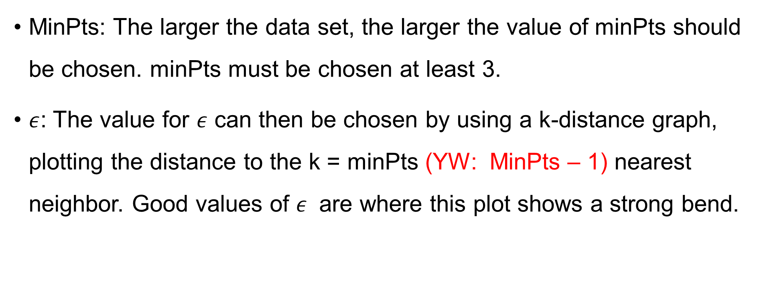
DBSCAN: Density Based Clustering Parameter Estimation
MinPts: The larger the data set, the larger the value of minPts should be chosen. minPts must be chosen at least 3.
$ε$: The value for $ε$ can then be chosen by using a k-distance graph, plotting the distance to the k = minPts (YW: MinPts – 1) nearest neighbor. Good values of $ε$ are where this plot shows a strong bend.

Slide 13
DBSCAN: Density Based Clustering Advantages
1. Unlike K-means, DBSCAN does not require the user to specify the number of clusters to be generated.
2 . DBSCAN can find any shape of clusters. The cluster doesn’t have to be circular.
3. DBSCAN can identify outliers

